Slide 1
TRADING BUSINESS
BUY GOODS ,WITH THE INTENTION TO SELL, FROM A SUPPLIER AT COST PRICE
ADD A MARK UP ON THE COST PRICE.
SELL THE GOODS AT SELLING PRICE TO MAKE A PROFIT ☺
CP + MU = SP

Slide 2
BUY THE GOODS TO SELL.
“ISSUED A CHEQUE TO THE SUPPLIER, GO TRADERS, FOR GOODS R200. “
SOURCE DOCUMENT?
CHEQUE COUNTERFOIL
JOURNAL?
CASH PAYMENTS JOURNAL [CPJ]
POST TO GENERAL LEDGER?
DEBIT: TRADING STOCK A + R200 [CP]
CREDIT: BANK A - R200

Slide 3
Purchasing your trading stock by cheque payments
In which Journal do you record cheque payments?
Answer: Cash Payments Journal
Which two accounts will you Debit & Credit in the General Ledger when posting from the CPJ?
DR “whatever you paid for” Eg. Trading Stock [A+]
CR Bank [A-]
Ideally we like to BUY GOODS on CREDIT from suppliers & SELL GOODS to customers for CASH.
WHY buy on account [credit]& sell for cash?
Discuss with your neighbour ☺

Slide 4
WE BUY GOODS ON ACCOUNT !
“We buy goods on account/credit from our suppliers and pay them back after 90 days ☺”
What do we call people we owe money to?
Answer: CREDITORS [Current Liability]
Which document will the supplier give us?
Answer: Original Invoice. Because we “O” get it!☺
Which journal do we record a credit purchase in?
Answer: CREDITORS Journal [CJ]☺
Which two accounts will we Dr & Cr in the General ledger when we post from the CJ?
Dr “whatever you bought”Cr Creditors Control L+

Slide 5
SOLD THE GOODS
“SOLD GOODS FOR R300 CASH.”
SOURCE DOCUMENT?
CASH REGISTER ROLL [CRR]
JOURNAL?
CASH RECEIPTS JOURNAL [CRJ]
POST TO GENERAL LEDGER [GL]
DEBIT: BANK A+ R300
CREDIT: SALES I + O + R300 [SP]
HOW MUCH STOCK DO YOU HAVE LEFT?

Slide 6
Two entries are recorded every time you SELL stock !
1.Record Selling Price [SP]
Cash received recorded in “Bank” column and Selling Price recorded in “Sales” column in CRJ.
Debit: Bank a/c A + with “Selling Price”
Credit: Sales a/c I + O + with “Selling Price”
2.Record Cost Price of goods sold [CP]
The sold goods will reduce the amount of stock you own at “Cost Price”.
Record in “Cost of Sales “ column in CRJ.
Debit: Cost of Sales E + O – with “Cost Price”
Credit: Trading Stock A – with “Cost Price”

Slide 7
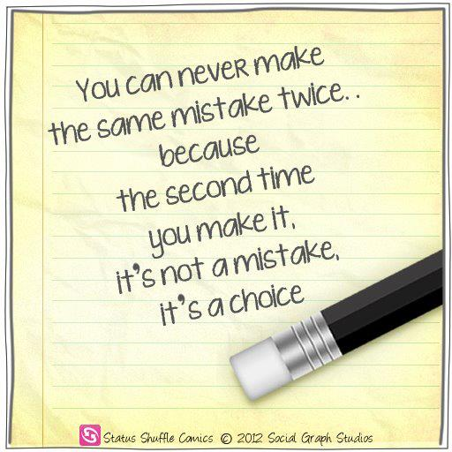

Slide 8
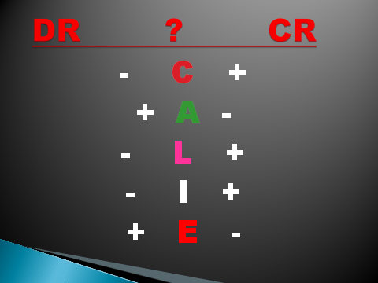
DOUBLE ENTRY SYSTEM

Slide 9
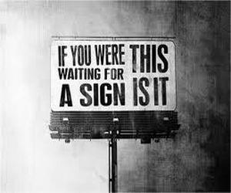

Slide 10


Slide 11
Look out for the BIG 5 ☺
Trading Stock
Debtors Control
Bank
Creditors Control
Sales
Cost of Sales
There are only three kinds of people…those who can count and those who can’t ☺

Slide 12
TRADING STOCK
DEBIT + A
A - CREDIT
1 BALANCE B/D
31 BANK CPJ
31 CREDITORS CONTROL CJ
31 COST OF SALES DAJ
1 BALANCE B/D
31 COST OF SALES DJ
31 COST OF SALES CRJ
31 BALANC E C/D

Slide 13
CREDITORS CONTROL
DEBIT - L
L + CREDIT
31 BANK CPJ
31 Creditors Allowances CAJ
31 BALANCE C/D
1 BALANCE B/D
31 SUNDRY PURCHASES CJ
1 BALANCE B/D

Slide 14
DEBTORS CONTROL [SP]
DEBIT + A
A - CREDIT
1 BALANCE B/D
31 SALES DJ
31 BANK [EFT CANCEL] CPJ
1 BALANCE B/D
31 BANK CRJ
31 DEBTORS ALLOW DAJ
31 BALANC E C/D

Slide 15
You mark up your goods by 50%.
CP ANSWER?
SP X100/(100+MU) = CP
R300 X 100/150 = R200 = CP
“You bought the goods for R200, then you marked up by R100 to sell for R300 cash.”
CP + MU = SP R200 + R100 = R300
RECORDED IN CRJ:
R200 UNDER “COST OF SALES” COLUMN:
POST TO GL
DEBIT: COST OF SALES E + O – R200
CREDIT: TRADING STOCK A - R200 [CP]

Slide 16
FORMULAS TO KNOW ☺
MU = SP – CP
GROSS PROFIT = SALES – COST OF SALES
CP + MU = SP
COST OF SALES = SALES X 100 / (100 + MU)
SALES = COST OF SALES X (100 + MU) /100
MU = COST OF SALES X MU% /100 OR
MU = SALES X MU% / (100 + MU)
MU ON CP % POLICY = MU / CP X 100
MEERKAT METHOD: WHAT YOU ARE LOOKING FOR IS ON TOP & WHAT YOU HAVE IN RANDS ALREADY IS BELOW ☺ ( NEED / GOT )

Slide 17
DOUBLE ENTRY SYSTEM

