Slide 1

ACCOUNTING
Grade 10 MODULE 3
LESSON 4 & 5

Slide 2

EFT
PAYMENT
To make
Instruction from an accountholder to their bank to make payment on their behalf to a third party.

Slide 3

INTERNET BANKING
Normal method of payment
Convenience -24/7
What services are available online?
  Check account balances
  Download statements
  Funds can be transferred between linked accounts
  Traders can pay their regular creditors/suppliers electronically,
    Once off payments are also possible
  Can have an option to ‘pay now’ or ‘pay later’
  Monthly bills can be paid electronically (e.g. Utility bill, Insurance etc)
  Wages & Salaries of staff can be paid electronically

Slide 4

INTERNET BANKING
The account holder CAN NOT do the
following
  Cash deposits
  Cash withdrawals
Trader receives (CRJ) an electronic
payment = source document is the
Bank Statement.
Trader makes (CPJ) an electronic
payment = the source document is the
Bank Statement.

Slide 5
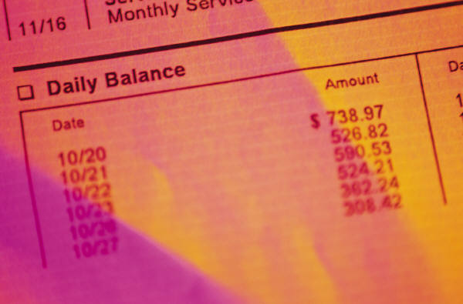
BANK STATEMENT
Compare their records with the bank statement at the end of the month = BANK RECONCILIATIONBusiness keeps record in CRJ and CPJ
Bank Account in books vs Actual Physical Account
.

Slide 6

BANK STATEMENT
The Bank statement shows the following details:
  Name & address of the business
  Account number
  Opening balance
  Deposits and withdrawals
  Bank charges (services fees etc) & interest on overdraft
  Debit and stop orders
  Closing balance

Slide 7

BANK CHARGES
Fees = INCOME for the bank
Current account are used –
convenient & efficient for transferring funds
Thus charged bank charges include: service fees, credit card levies & cash deposit fees
These costs are deducted off the clients bank account
These costs are reflected on the bank statement
Source document is a Bank statement
Recorded in CPJ & posted to Bank charges

Slide 8
BANK OVERDRAFT
An overdraft is a negotiated loan
from the Bank
Spend more
than is in his account
Must have prior arrangement
Bank sets an overdraft limit
Limit is set according to financial status of
Business – credit rating
+ A Bank L +
Favourable
Unfavourable

Slide 9
INTEREST ON OVERDRAFT
Interest is charged on the overdraft facility
CAN NOT be added to bank charges
Separate account = Interest on overdraft
(concept of materiality)
It is an operating expense
Source document is the Bank Statement
It is recorded in the CPJ and is an operating
expense.

Slide 10

NEGOTIATING A LOAN
If an owner does not have enough capital he will have to
supplement it
Can apply for a long-term loan from a
financial institution.
Will need to provide proof that you can repay
loan + interest (security/collateral)
  property, surety, insurance policies, income, REFerences
Amount will be stipulated + % interest rate + terms of repayment
Bank transfer loan into current account
Record receipt of loan in CRJ
Post to General ledger – credit Loan(liability) debit Bank (asset)

Slide 12
INTEREST ON LOAN
Interest charged on a fixed rate (%) for a period of time
The % rate will always be per annum =12 MONTHS
example: 20 000 x 10% x 1/12
= R166. 67 per month
Interest is usually capitalised to the loan account
  i.e the amount of interest is added to the loan account
  debit Interest on loan E + O - & credit Loan L +
If interest is NOT capitalised, but paid separately:
  debit interest on loan E + O - & credit Bank A -

Slide 13
REPAYING A LOAN
Terms of repayment are stipulated in loan agreement
Can be paid back:
  In one repayment
  Paid in monthly instalments
Transactions recorded in CPJ
Post to the general ledger:
  Debit Loan (liability decreasing)
  Credit Bank (asset decreasing)
If interest is capitalised the amount entered in the CPJ will only
reflect one entry. Payment includes both the interest + Loan
If interest is paid separately then CPJ will have TWO entries

Slide 14

FIXED DEPOSIT
There are many investment opportunities
One way = FIXED DEPOSIT
Advantage = higher interest % rate
However, it must be invested for a certain time period without being withdrawn, e.g. 6mo, 5 yrs etc
When deposited in bank = recorded in CPJ
Post to general ledger:
  Credit Bank (Asset) decreasing A- MONEY OUT
  Debit Fixed Deposit (Asset) increasing + A

Slide 15
FIXED DEPOSIT cont
When the Fixed deposit matures(falls due) the money received is recorded in the CRJ
It is posted to the General ledger:
  Debit Bank (asset) increases
  Credit Fixed deposit (asset) decreases
Interest on Fixed deposit must be CAPITALISED
  i.e added to the sum of Fixed deposit
  Debit Fixed deposit (asset) increases
  Credit Interest on Fixed deposit (income) increases ☺+

Slide 16
FIXED DEPOSIT cont
If the investor requests that the interest be paid to the investor on a regular basis monthly or quarterly the entry will be made in the CRJ
It is posted to the general ledger:
  Debit Bank (asset) increases
  Credit Interest on Fixed deposit (income) increases

Slide 17

CARRIAGE ON PURCHASES
Any expense incurred in purchasing stock is charged directly to
TRADING STOCK
Such expenses increase the value
of stock.
Examples of transport costs:
railage, freight, customs duty,
import duty
It is a buying expense Include in Trading Stock.
Carriage on Sale is a selling expense &
regarded as delivery expense

Slide 18

CREDIT CARD &
DEBIT CARD SALES
Most businesses accept credit or debit cards as payment
Eliminates the need to carry large amounts of cash
Cashier swipes the card & voucher slip showing total purchases is produced.
The customer keeps a copy & the trader retains a copy
At the end of the day the cashier adds up all vouchers, cheques & cash received for the day

Slide 19
CREDIT CARD &
DEBIT CARD SALES cont
The money for credit/debit card sales will be transferred directly into the business account
The business needs to note the following
  Credit Card sales are regarded as cash sales – CRJ
  Source document for CC sales is the Bank statement
  The bank charges a levy on each credit card transaction. This levy would appear on the trader’s bank statement and treated as bank charges.
  For debit cards the customer pays the costs.

