Slide 1
Creative thinking
Grade 10
Chapter 12.1

Slide 2
Creative thinking is the ability to see something in a new way.
“
”

Slide 3
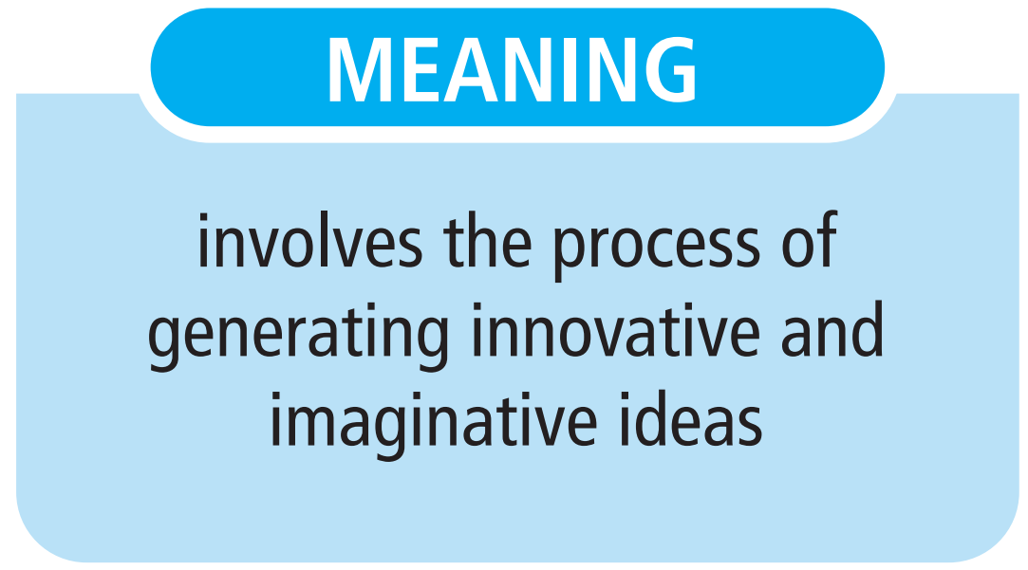

Slide 4
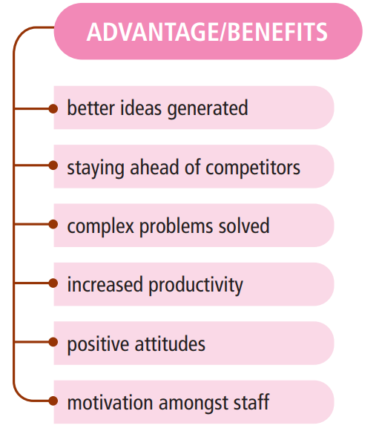

Slide 5
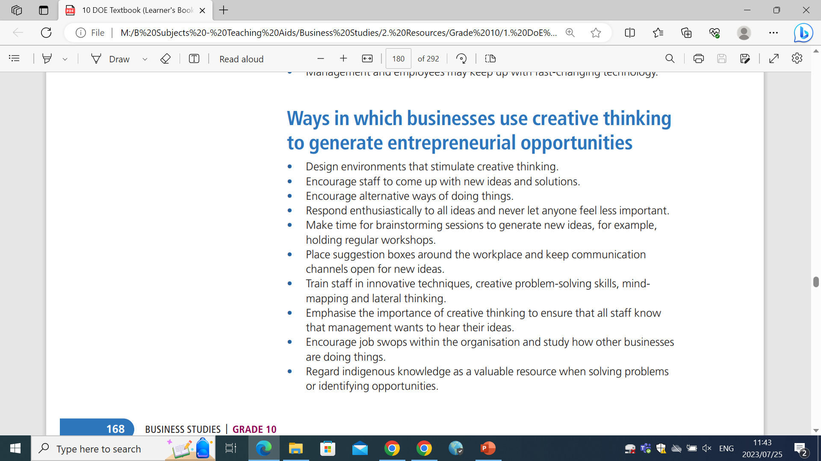
Ways in which businesses can use creative thinking to generate entrepreneurial opportunities

Slide 6
Ways in which businesses can use creative thinking to generate entrepreneurial opportunities

Slide 7
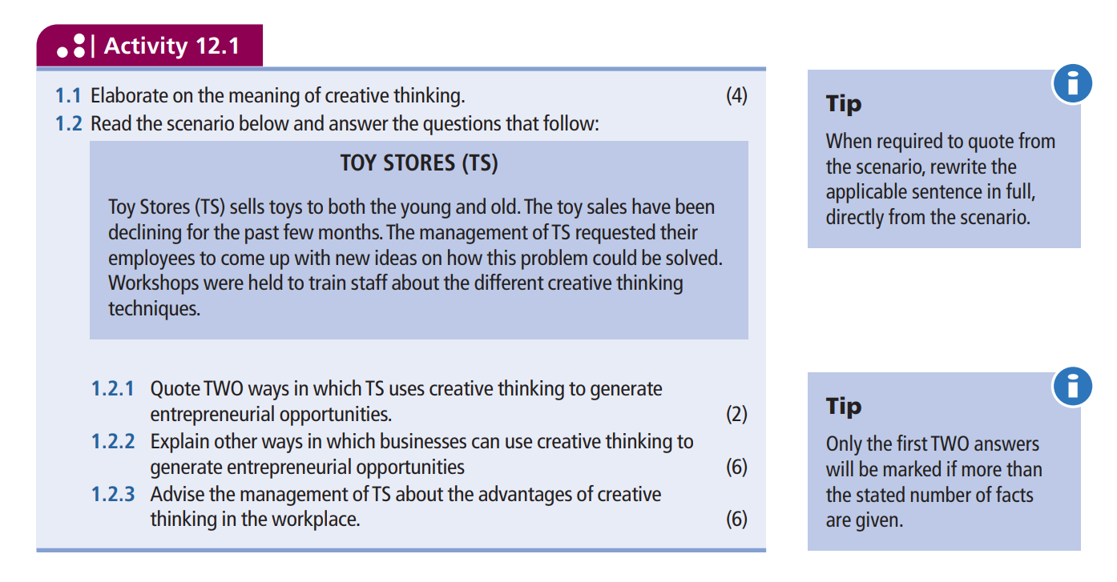
Your turn (p.169)

Slide 8
QUIZ – Question 1
Match the columns
Term | Definition
1.1. Creative thinking | The process of finding solutions to difficult or complex issues.
1.2. Problem-solving | B. The local knowledge that is unique to a given culture or society.
1.3. Indigenous knowledge | C. The process of generating innovative and imaginative ideas.
 | D. A business practice that is economically viable, socially responsible and environmentally friendly.

Slide 9
QUIZ – Question 2 short answer questions
2.1 List any TWO advantages of creative thinking.

Slide 10
QUIZ – MEMO (5 MARKS)
ANY TWO
Term
1.1. C
1.2. A
1.3. B

Slide 11
Problem solving
Grade 10
Chapter 12.2

Slide 12
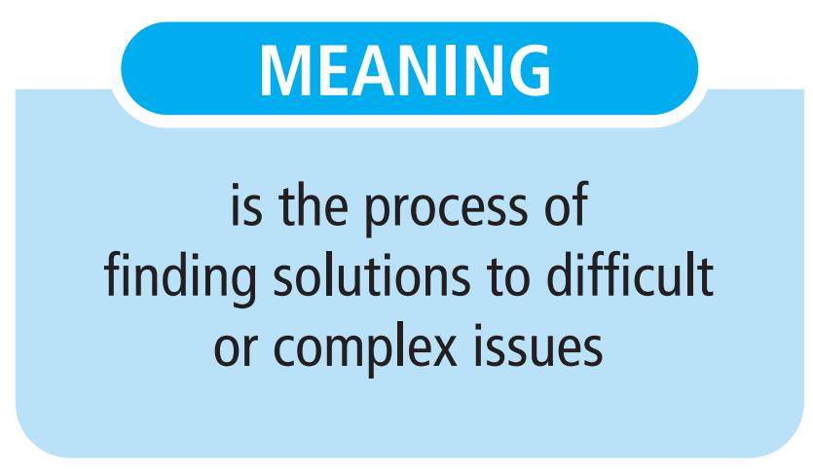

Slide 13
EFFECTIVE PROBLEM SOLVING RESULTS IN GOOD DECISION-MAKING.
“
”

Slide 14
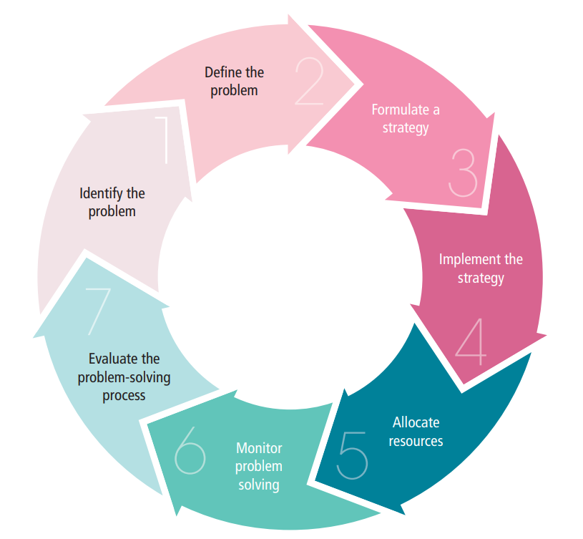
Problem solving CYCLE

Slide 15
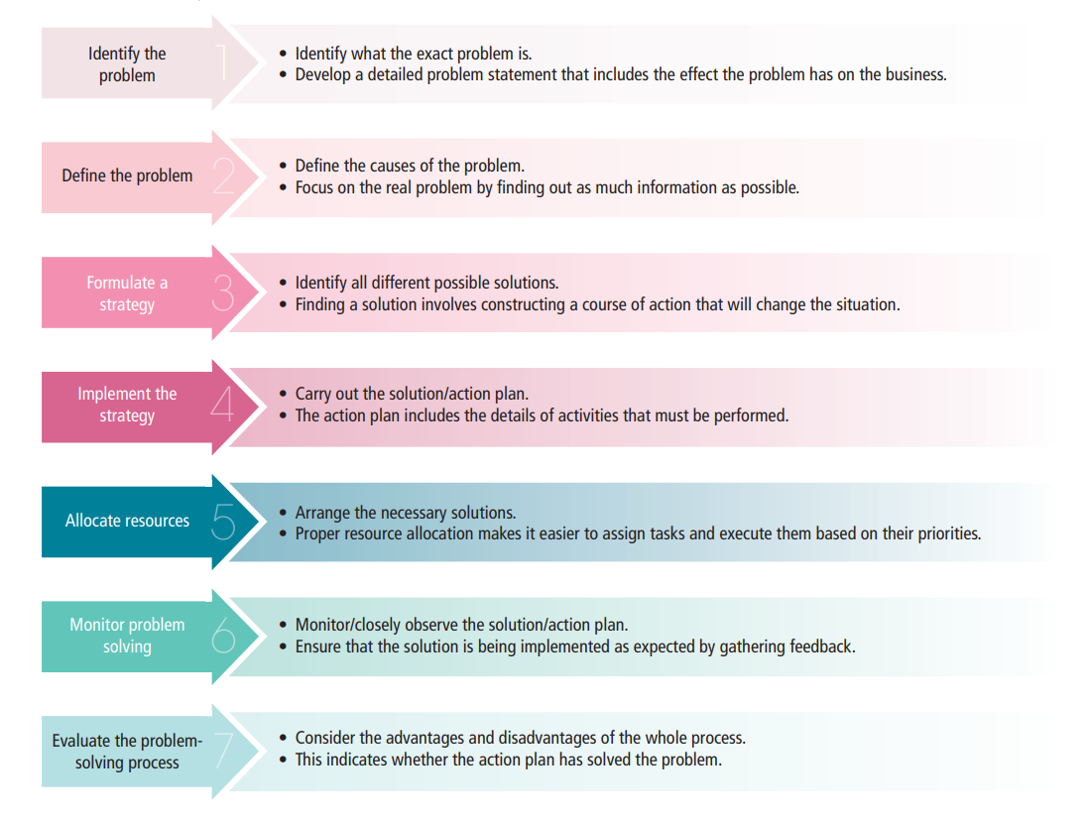
Problem solving CYCLE steps

Slide 16
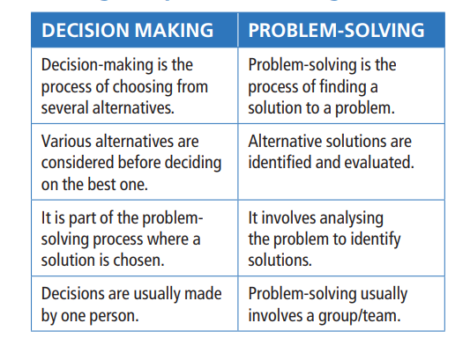
Differences between decision making and problem-solving

Slide 17
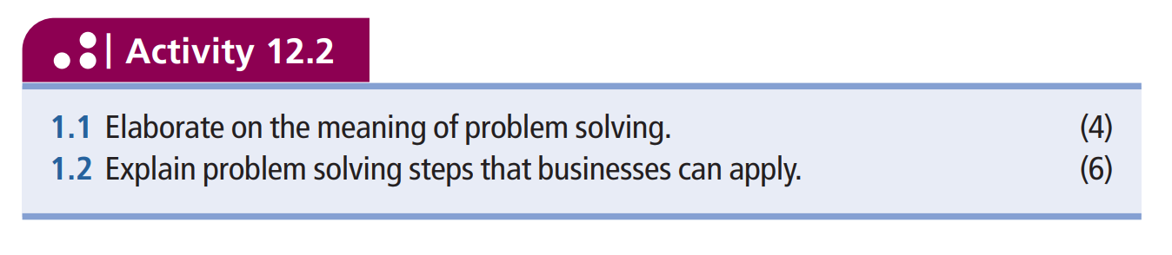
Your turn (p.172)

Slide 18
Problem solving techniques
Grade 10
Chapter 12.3

Slide 19
PROBLEM SOLVING TECHNIQUE | EXPLANATION
EMPTY –CHAIR TECHNIQUE | A METHOD THAT RELIES ON A PANEL OF EXPERTS TO FIND SOLUTIONS TO A PROBLEM
2. DELPHI TECHNIQUE | B. A GROUP ACTIVITY TO FIND A SOLUTION FOR A SPECIFIC PROBLEM BY GATHERING A LIST OF IDEAS SPONTANEOUSLY
3. NOMINAL GROUP TECHNIQUE | C. A STRUCTURED METHOD FOR GROUP BRAINSTORMING THAT ALLOWS EVERYONE TO COME UP WITH IDEAS ON THEIR OWN
4. MIND MAPPING | D. A ROLE-PLAY EXERCISE THAT PLACES A PERSON ACROSS FROM AN EMPTY CHAIR
5. BRAINSTORMING | E. A TECHNIQUE USED TO DETERMINE THE FORCES THAT ARE FOR AND AGAINST A DECISION.
6. FORCE FIELD ANALYSIS | F. DIAGRAMS THAT REPRESENT IDEAS THAT ARE CONNECTED TO A CENTRAL THEME
MATCH THE COLUMNS

Slide 20
VIDEO:
How to Generate Ideas with the SCAMPER Technique

Slide 21
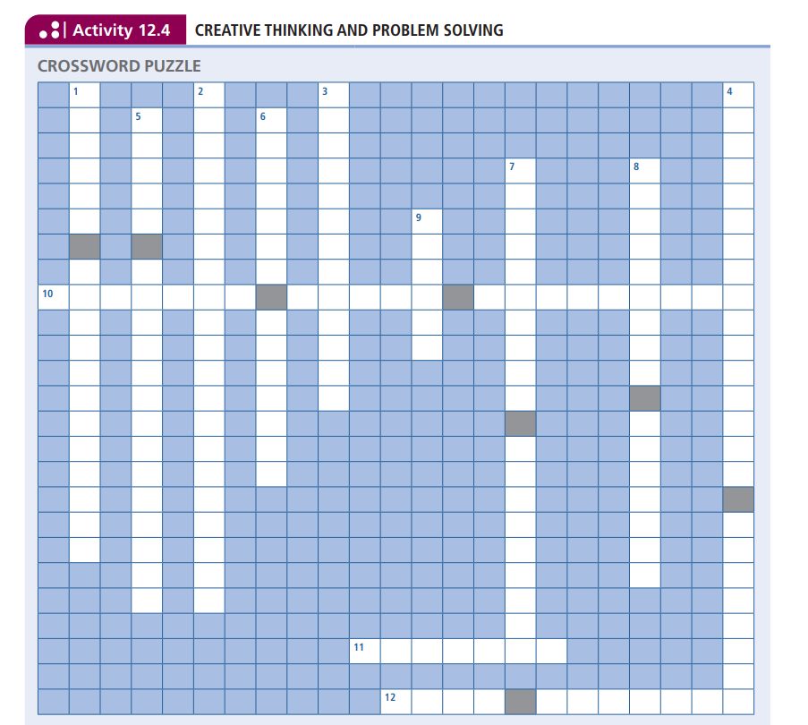
TEST YOURSELF – page 181
TRY DO THIS CROSSWORD ON YOUR OWN & WITHOUT LOOKING BACK IN YOUR BOOK

