Slide 1
Look out for the BIG 5 ☺
Trading Stock
Debtors Control
Bank
Creditors Control
Sales
Cost of Sales
There are only three kinds of people…those who can count and those who can’t ☺

Slide 2
GENERAL LEDGER REVISION
Using the information below complete the following General Ledger accounts for March 2015 for Wade & Amy Stores: Balances on 1 March in brackets.
Trading Stock R20 000, Debtors Control R5 000, Bank R10 000, Creditors Control R7 000, Sales R100 000, Cost of sales R80 000, Debtors Allowances R10 000.
The following balances appeared in the books of Wade & Amy Stores
Extracted Totals of Journals on 31 March 2015:
Cash Receipts Journal (CRJ 12): Cash Payments Journal (CPJ 12):
Bank R23 000 Bank R14 000
Sales R16 000 Creditors Control R1 500
Cost of Sale R12 640 Packing Material R300
Debtors Control R2 500 Trading Stock R15 000
Creditors Journal (CJ 12): Debtors Journal (DJ 12):
Creditors Control R8 000 Sales R12 000
Packing Material R1 000 Cost of Sales R?
Trading Stock R7 000
Debtors Allowances Journal (DAJ 12):
Debtors Allowances R5 000
Cost of Sales R4 000 WHICH ACCOUNTS DO WE DR & CR WHEN
POSTING TO THE GL?

Slide 3
The following balances appeared in the books of Wade & Amy Stores
Extracted Totals of Journals on 31 March 2015:
Cash Receipts Journal (CRJ 12): Cash Payments Journal (CPJ 12):
DR Bank R23 000 CR Bank R14 000
CR Sales R16 000 DR Creditors Control R1 500
DR Cost of Sales R12 640 DR Packing Material R300
CR Debtors Control R2 500 DR Trading Stock R15 000
Creditors Journal (CJ 12): Debtors Journal (DJ 12):
CR Creditors Control R8 000 Sales R12 000
DR Packing Material R1 000 Cost of Sales R?
DR Trading Stock R7 000
Debtors Allowances Journal (DAJ 12):
Debtors Allowances R5 000 DR DEBTORS ALLOWANCES SP
CR DEBTORS CONTROL SP
Cost of Sales R4 000 CR COST OF SALES CP
DR TRADING STOCK CP
DEBTORS JJOURNAL
DR DEBTORS CONTROL CR SALES SP
DR COST OF SALES CR TRADING STOCK CP SAME AS CRJ

Slide 4
TRADING STOCK
DR + A ‘BUY’ more
A - ‘SELL’ less CR
1 BALANCE B/D
31 BANK CPJ
31 CREDITORS CJ
31 COST OF SALES DAJ
1 BALANCE B/D
31 COST OF SALES DJ
31 COST OF SALES CRJ
31 CREDITORS CAJ
31 BALANCE C/D

Slide 5


Slide 6
DEBTORS CONTROL
DEBIT + A
A - CREDIT
1 BALANCE B/D
31 SALES DJ
31 Bank [EFT cancel) CPJ
1 BALANCE B/D
31 BANK + DISCOUNT CRJ
31 DEBTORS ALLOWANCES DAJ
31 BALANCE C/D

Slide 7
CREDITORS CONTROL
DR - L WE OWE LESS
L + CR WE OWE MORE
31 BANK+DISCOUNT CPJ
31 Creditors Allowances CAJ
31 BALANCE C/D
1 BALANCE B/D
31 SUNDRY PURCHASES CJ
1 BALANCE B/D

Slide 8


Slide 9
BANK
DR “Deposits” + A
“Cheque Payments” A - CR
1 Balance b/d
31 Total Receipts CRJ
1 Balance b/d
31 Total Payments CPJ
31 Balance c/d

Slide 10
SALES
I + ☺ CR
DR - I ☹
1 Total b/d
31 Bank CRJ
31 Debtors Control DJ
“Total”

Slide 11
DEBTORS ALLOWANCES (SP)
DR I - ☹
I + ☺ CR
1 Total b/d
31 Debtors
Control DAJ
“Total”

Slide 12
COST OF SALES (CP)
DR MIRROR IMAGE OF TS
MIRROR IMAGE OF TS CR
1 Total b/d
31 Trading Stock CRJ
31 Trading Stock DJ
Pencil Dr-Cr
31 Trading Stock DAJ

Slide 13
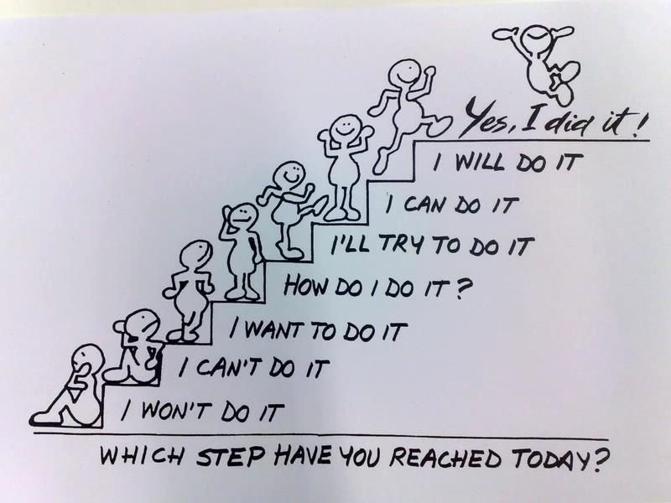
You are in charge of your attitude ☺☺

